Slide 1


DIAGNOSE ME PROJECT
Realtime remote diagnose system of COVID-19 suspected cases
In order to reduce the risk of transmission on the way to the hospital and promote rapid management, our project will implement a mobile application for remote self-diagnosis of symptoms (thanks to connected objects) and suspected cases mapping so that a specialized ambulance can travel to the scene to remove the suspect patient.

Slide 2

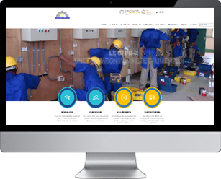

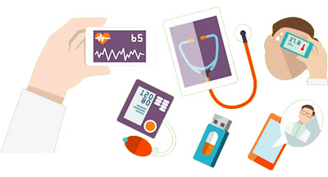




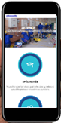

Email: inedit.bf@gmail.com
WeChat ID: ineditbf
2
COVID-19 SYMPTOMS DETECTION
1
IOT
DIAGNOSE ME PROJECT
DiagnoseMe
Realtime remote diagnose system of COVID-19 suspected cases
In order to reduce the risk of transmission on the way to the hospital and promote rapid management, our project will implement a mobile application for remote self-diagnosis of symptoms (thanks to connected objects) and suspected cases mapping so that a specialized ambulance can travel to the scene to remove the suspect patient.
3

Slide 3
Email: inedit.bf@gmail.com
WeChat ID: ineditbf
2
COVID-19 SYMPTOMS DETECTION
1
IOT
DIAGNOSE ME PROJECT
DiagnoseMe
Realtime remote diagnose system of COVID-19 suspected cases
In order to reduce the risk of transmission on the way to the hospital and promote rapid management, our project will implement a mobile application for remote self-diagnosis of symptoms (thanks to connected objects) and suspected cases mapping so that a specialized ambulance can travel to the scene to remove the suspect patient.
3

Slide 4


TEAM MEMBERS
Pakindessama Maxime KONKOBO
Boris Flavy
BAGBILA
Sy Adama
TRAORE
24 years
Student
Wuhan University of Technology
24 years
Consultant
------
------
30 years
Consultant
Electronics and automation ingineer

